Slide 1
Comparing Scrum and Agile Development Models
Allen Downs
CS 250
SNHU

Slide 2


Scrum Roles
Cite: Coursera, 2022

Slide 3
Role: Product Owner
Maintains relationship with clients and stakeholders
Responsible for the client's vision being realized
Prioritizes backlog, pieces critical to the vision are first to be finished
Maintains accountability for the team's successes
Maintains accurate updates to clients

Slide 4
Role: Scrum Master
Facilitate in-team communication through daily scrum events, information radiators, etc.
Lead sprint assignments, and document sprint reviews and retrospectives
Keep a "pulse" on team members through individual communication
Manage obstacles by communicating with stakeholders with the Product Owner

Slide 5
Role: Developer
Help in planning sprints and setting goals
Expertise assists in design steps and development
Knowledge and data assists in finding best, most efficient way to develop product
Regular testing and quality assurance to make sure product works and satisfies success criteria

Slide 6

How Scrum Fulfills the Software Development Lifecycle
Cite: Glamazdina, 2021

Slide 7

Analysis
Input received from clients/stakeholders/users
Features itemized
Budget planned
Time scheduled

Slide 8
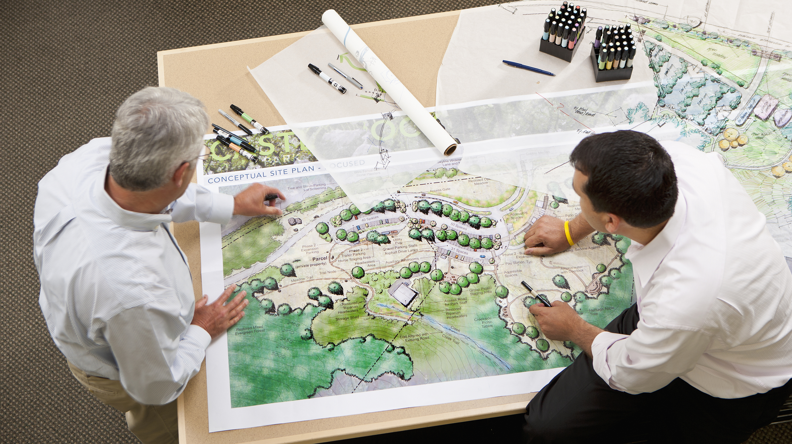
Design
System designed with psuedocode, flowcharts
UI/UX designed with mockups

Slide 9

Development
Coding time! Development team works in sprints to realize designs

Slide 10

Testing
Does the product function?
Does the product achieve what the clients want?
Are there any unexpected errors from development?

Slide 11

Deployment
When the product is ready, it needs to make its way to the client/users.
In public releases, data is gathered about the product for retrospective/review

Slide 12

Maintenance
Testing is never finished. User data and ongoing testing continues to gather data
Developers continue pushing patches to code to fix errors and add features.

Slide 13

Agile Compared to Waterfall
Cite: Glamazdina

Slide 14
Features of Agile
Development is always evolving, adapting, and ongoing
Progress is iterative
Regularly produces workable products, frequent testing
Team is cross-functional

Slide 15
Features of Waterfall
Development is determined from the start, allowing for fixed budgets and strict deadlines
Progress is sequential
Workable product only at the end of production
Team is specialized

Slide 16
When to Use Agile
The scope of the project is large or indeterminate
Budget and deadlines are flexible
Team is cross-functional
Iterative development ideal

Slide 17
When to Use Waterfall
Scope of the project is plannable from the start
Budget and deadlines are fixed
Team is specialized for their roles
Iterative development unnecessary

Slide 18
References
Coursera. (2022, October 31). The 3 scrum roles and responsibilities explained. Coursera. Retrieved February 17, 2023, from https://www.coursera.org/articles/scrum-roles-and-responsibilities
Glamazdina, Y. (2021, September 15). The Agile Software Development Life Cycle: What is agile SDLC and how to use it? The Agile Software Development Life Cycle: What is Agile SDLC and How To Use It? | Brocoders blog about software development. Retrieved February 19, 2023, from https://brocoders.com/blog/agile-software-development-life-cycle/#:~:text=There%20are%205%20phases%20within,testing%2Fdemonstrating%2C%20and%20retrospective.

